Slide 1
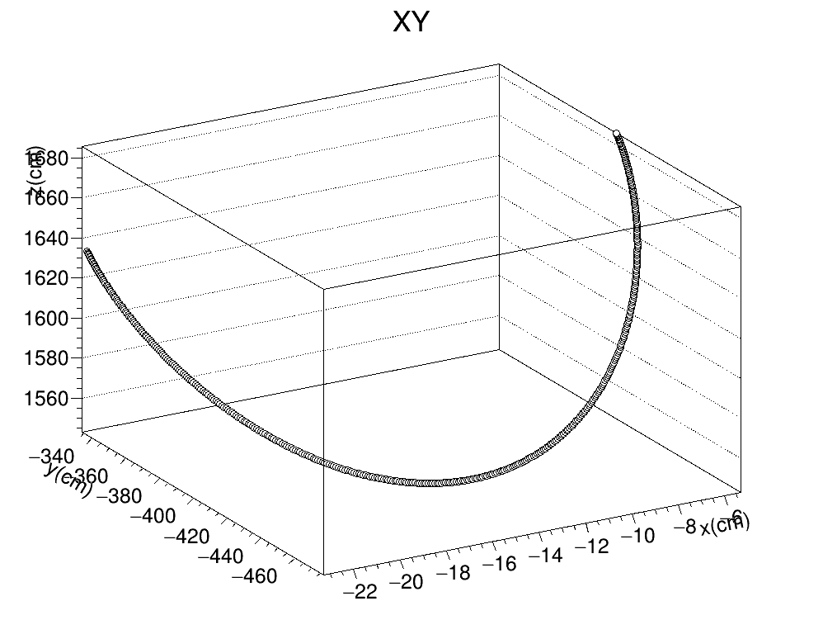
Toy monte carlo macro
Made a new ROOT macro, which produces a Toy Montecarlo file and applies our Kalman Filter to it
This is now completely independent from the art infrostructure and can be run directly from my machine
Also, while it produces the same final results it is structured differently so that the toy Montecarlo and Kalman filter application are not done in parallel anymore, but are done one after the other.
This allows for both a simple file with just xyz info and a post kalman filter file with all the info to be produced quite naturally

Slide 2
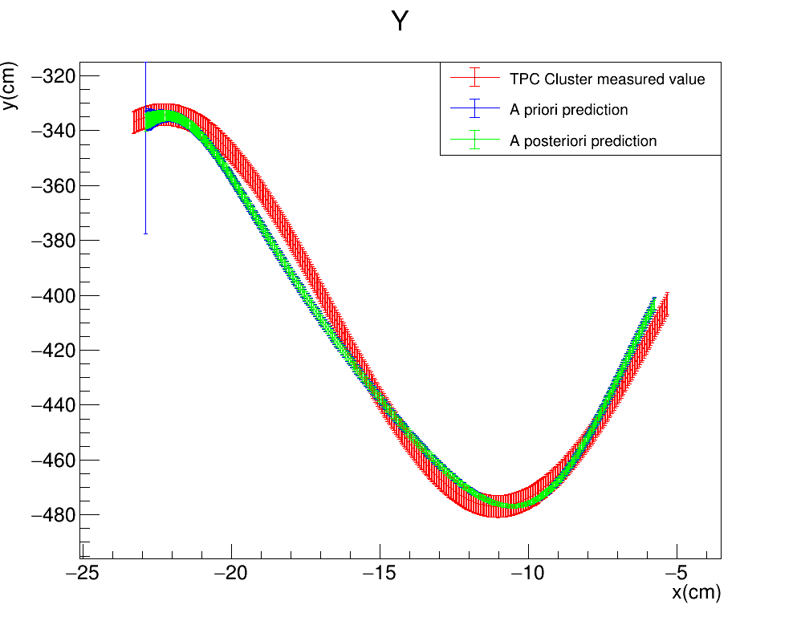


Toy monte carlo
KF™$: \left(σ_{x},σ_{yz}\right)=(0.5cm,1cm)$
To check that the Macro is working properly I compare the original helix plots with the ones produced using the new macro
Old modified art module
New ROOT macro
FILTER PROPAGATION DIRECTION

Slide 3
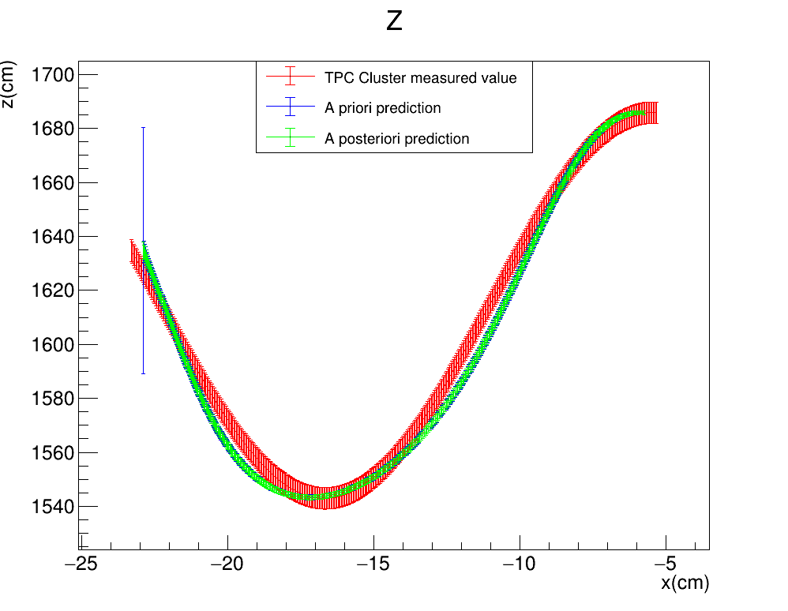

Toy monte carlo
KF™$: \left(σ_{x},σ_{yz}\right)=(0.5cm,1cm)$
To check that the Macro is working properly I compare the original helix plots with the ones produced using the new macro
Old modified art module
New ROOT macro
FILTER PROPAGATION DIRECTION

Slide 4
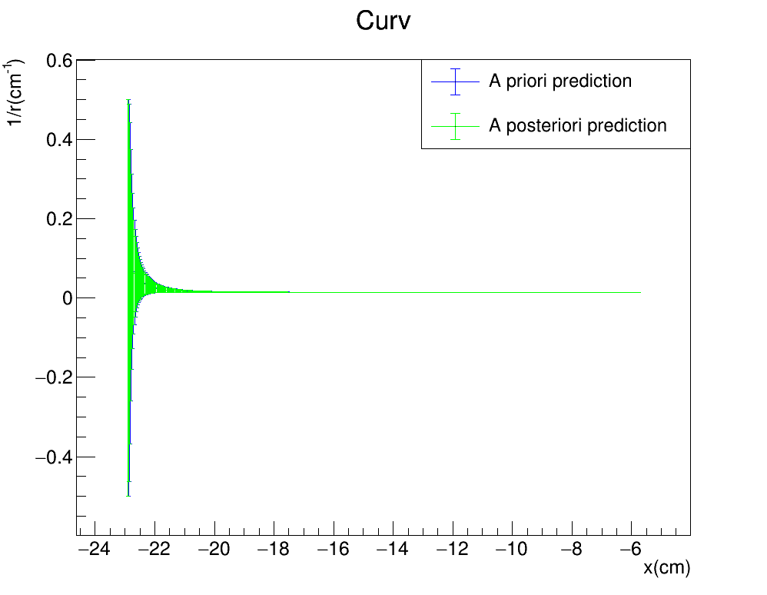
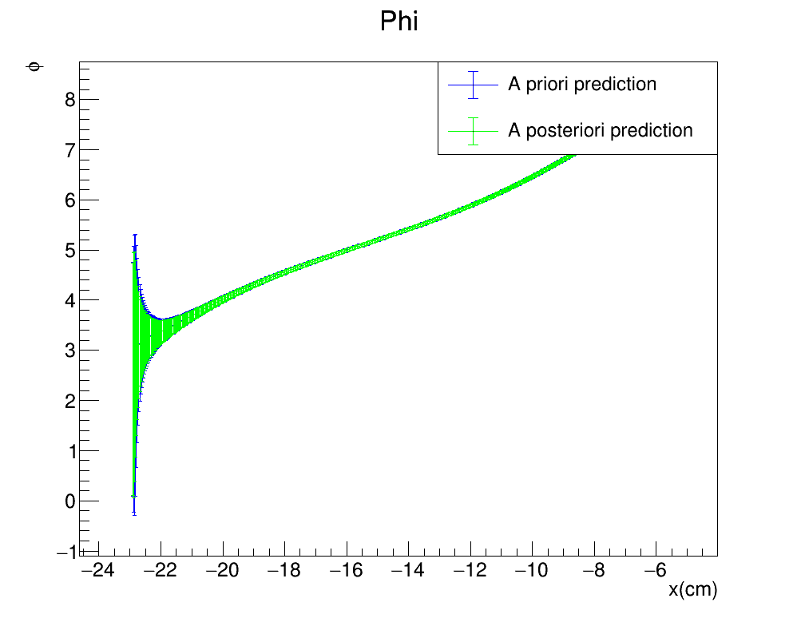
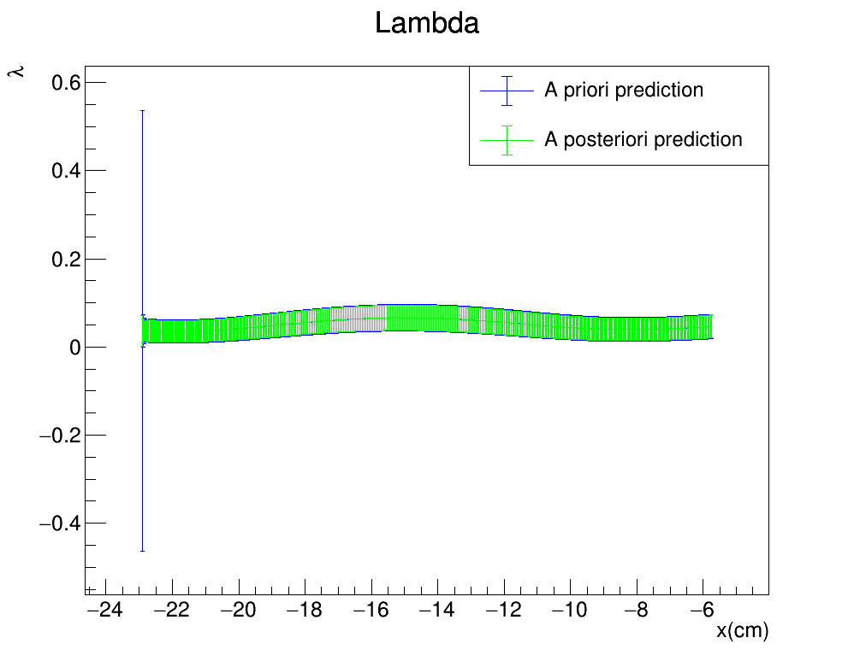



Toy monte carlo
KF™$: \left(σ_{x},σ_{yz}\right)=(0.5cm,1cm)$
Old modified art module
FILTER PROPAGATION DIRECTION
New ROOT macro

Slide 5
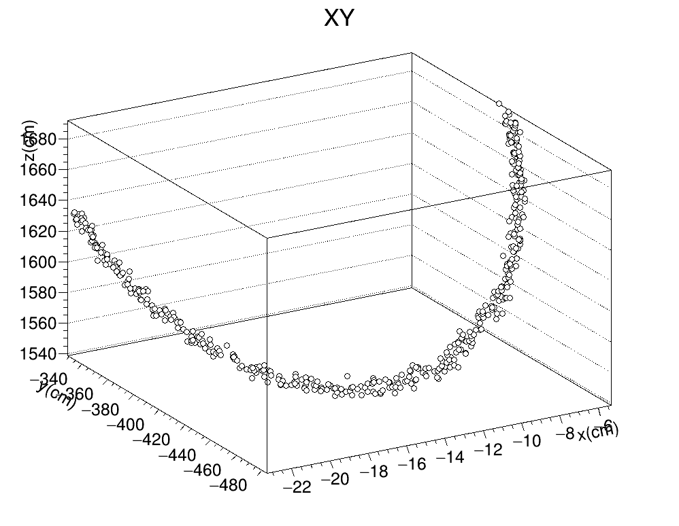
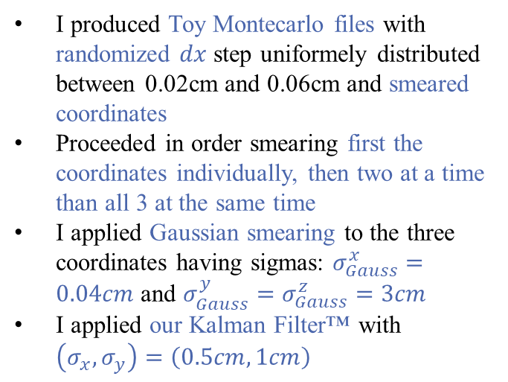
Toy monte carlo macro
I produced Toy Montecarlo files with randomized $dx$ step uniformely distributed between 0.02cm and 0.06cm and smeared coordinates
Proceeded in order smearing first the coordinates individually, then two at a time than all 3 at the same time
I applied Gaussian smearing to the three coordinates having sigmas: $σ_{Gauss}^{x}=0.04cm$ and $σ_{Gauss}^{y}=σ_{Gauss}^{z}=3cm$
I applied our Kalman Filter™ with $\left(σ_{x},σ_{y}\right)=\left(0.5cm,1cm\right)$
3D plot of the helix when all three coordinates are smeared

Slide 6
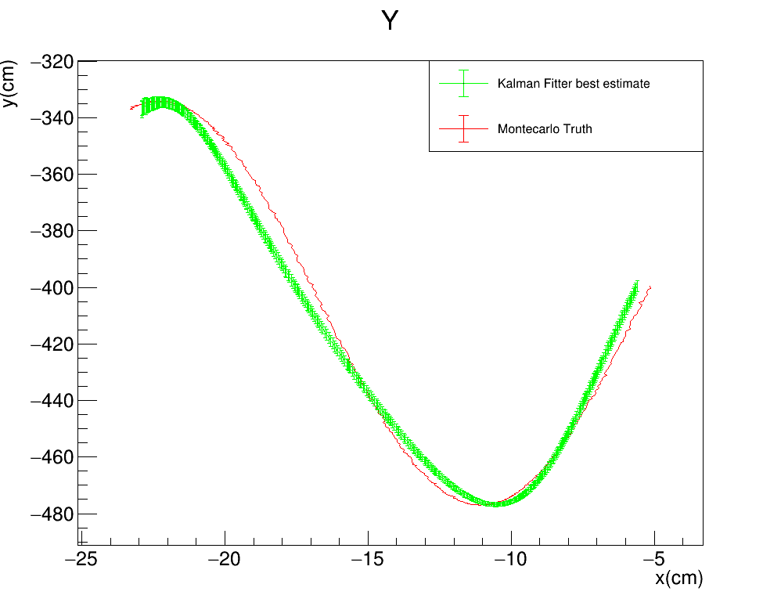
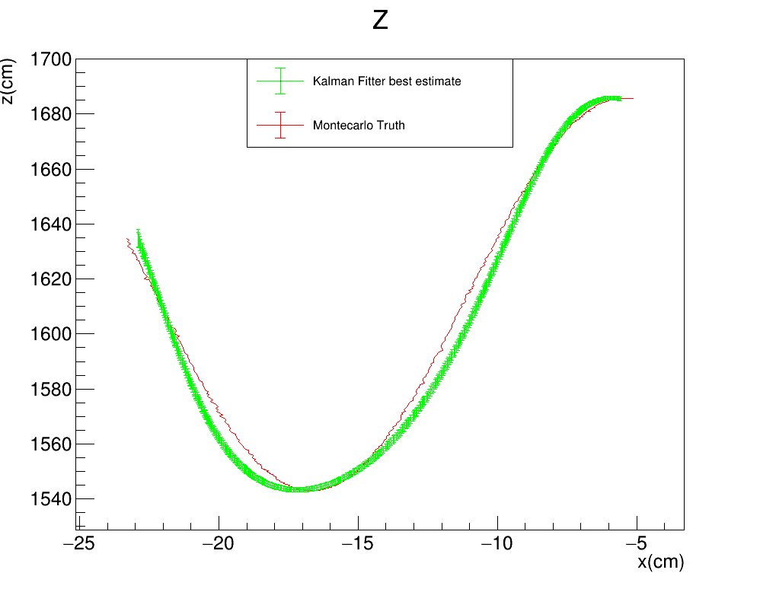


Toy monte carlo: SMEARED X
KF™$: \left(σ_{x},σ_{yz}\right)=(0.5cm,1cm)$
Gauss$: σ_{Gauss}^{x}=0.04cm$
FILTER PROPAGATION DIRECTION

Slide 7


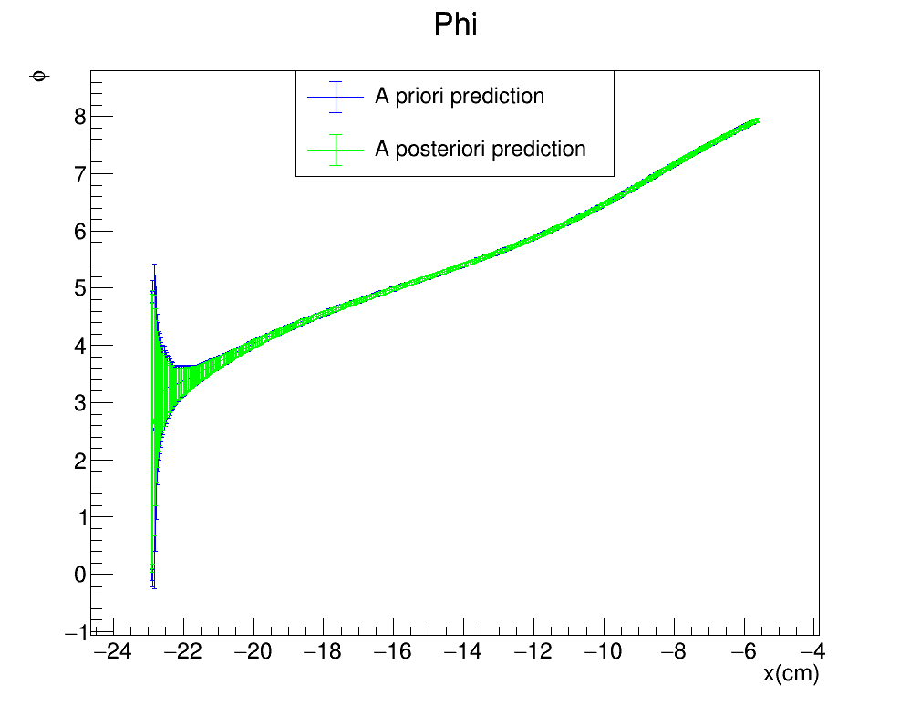
Toy monte carlo: SMEARED X
KF™$: \left(σ_{x},σ_{yz}\right)=(0.5cm,1cm)$
Gauss$: σ_{Gauss}^{x}=0.04cm$
FILTER PROPAGATION DIRECTION

Slide 8
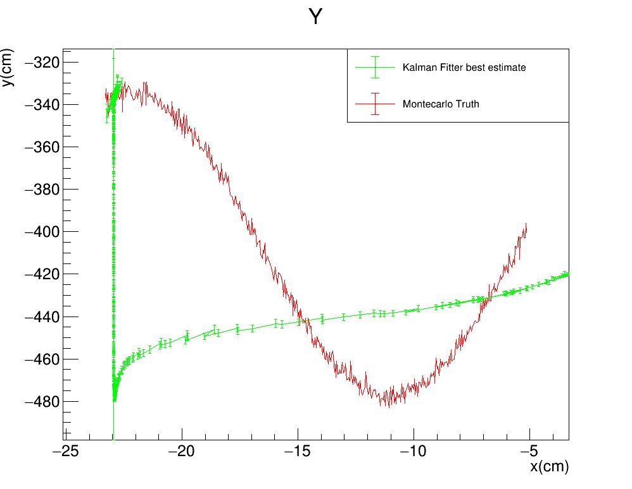
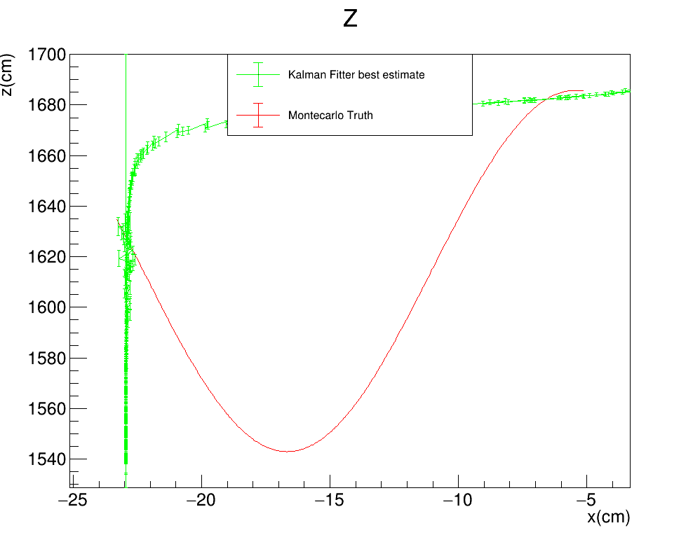

Toy monte carlo: SMEARED Y
KF™$: \left(σ_{x},σ_{yz}\right)=(0.5cm,1cm)$
Gauss$: σ_{Gauss}^{y}=3cm$
FILTER PROPAGATION DIRECTION

Slide 9
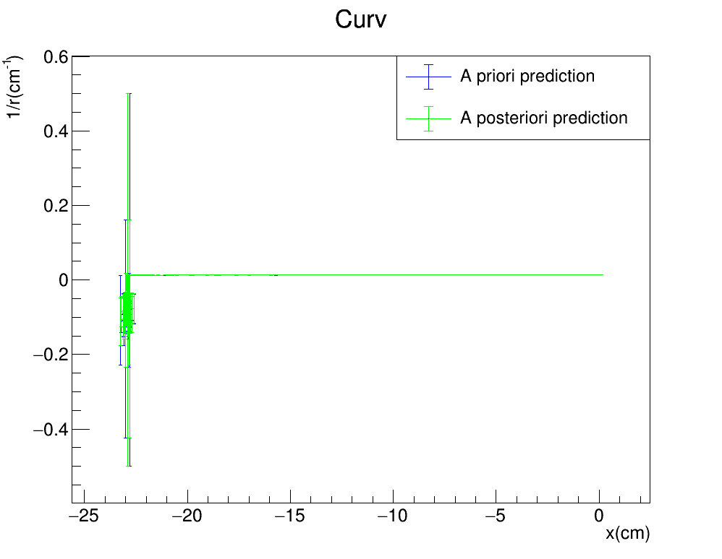
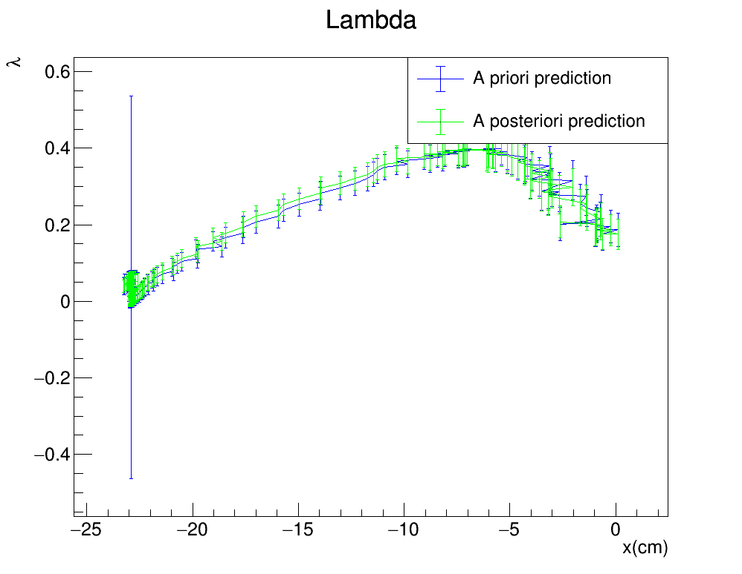
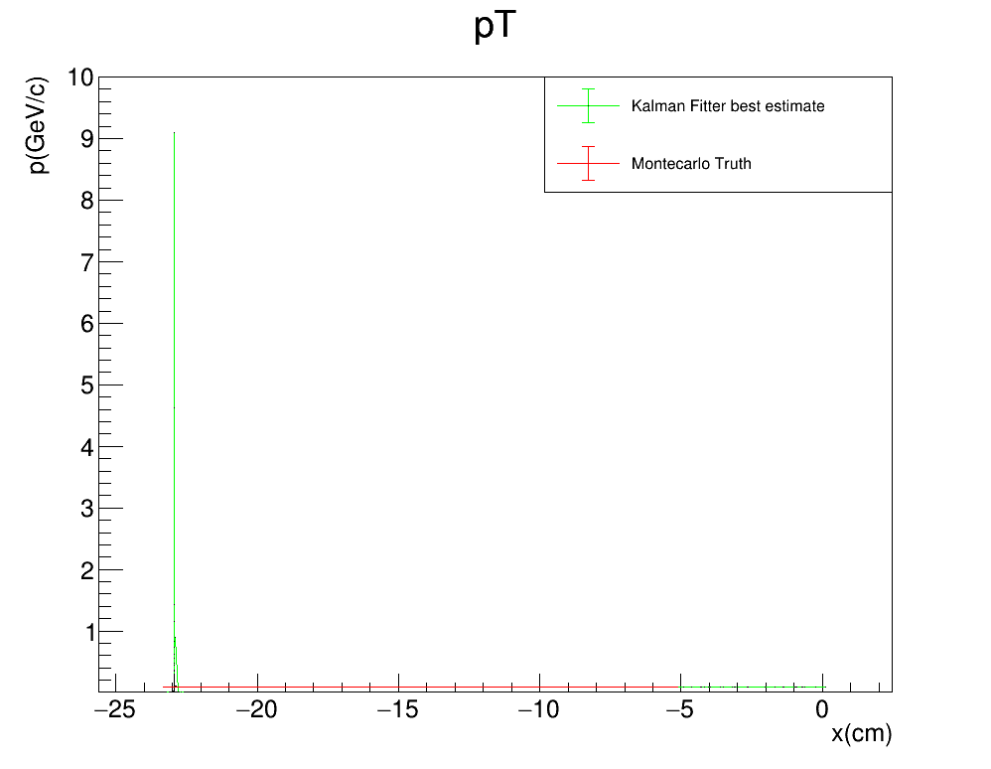
Toy monte carlo: SMEARED Y
KF™$: \left(σ_{x},σ_{yz}\right)=(0.5cm,1cm)$
Gauss$: σ_{Gauss}^{y}=3cm$
FILTER PROPAGATION DIRECTION

Slide 10
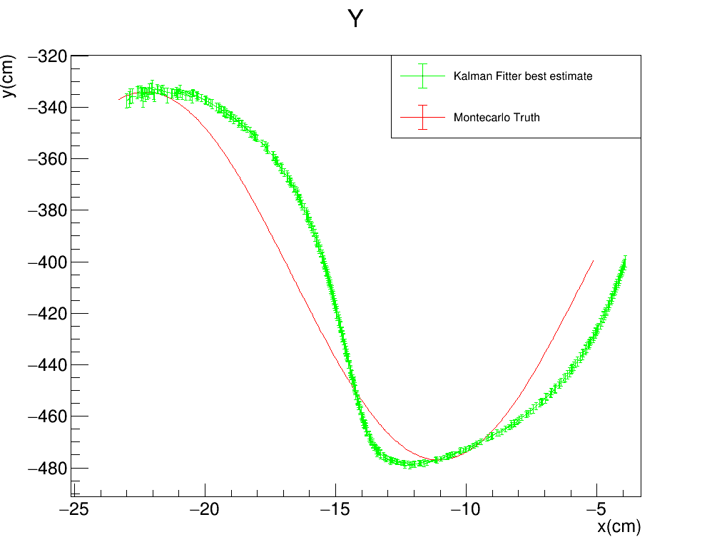
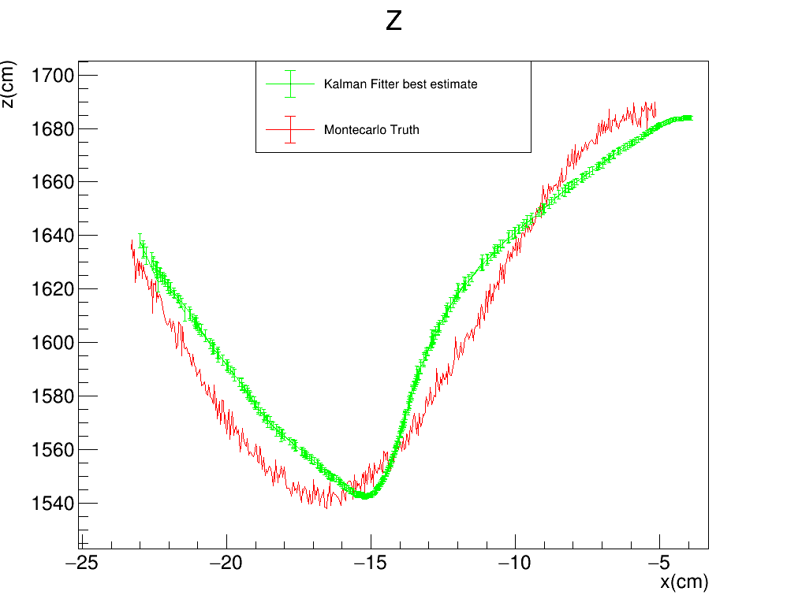

Toy monte carlo: SMEARED Z
KF™$: \left(σ_{x},σ_{yz}\right)=(0.5cm,1cm)$
Gauss$: σ_{Gauss}^{z}=3cm$
FILTER PROPAGATION DIRECTION

Slide 11
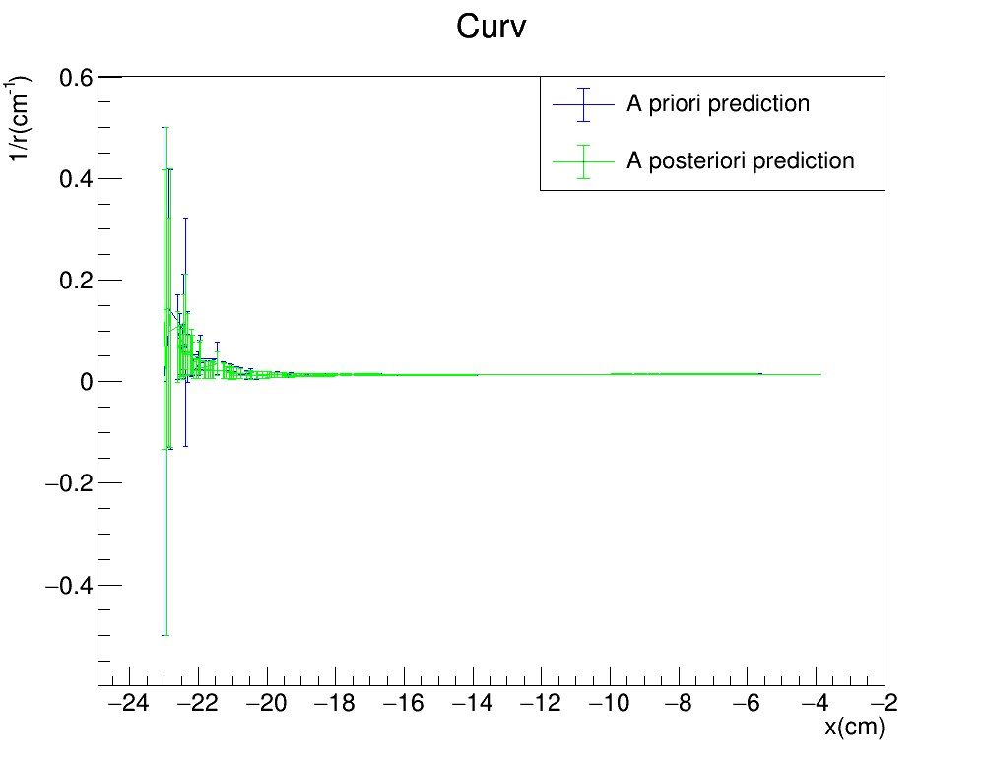
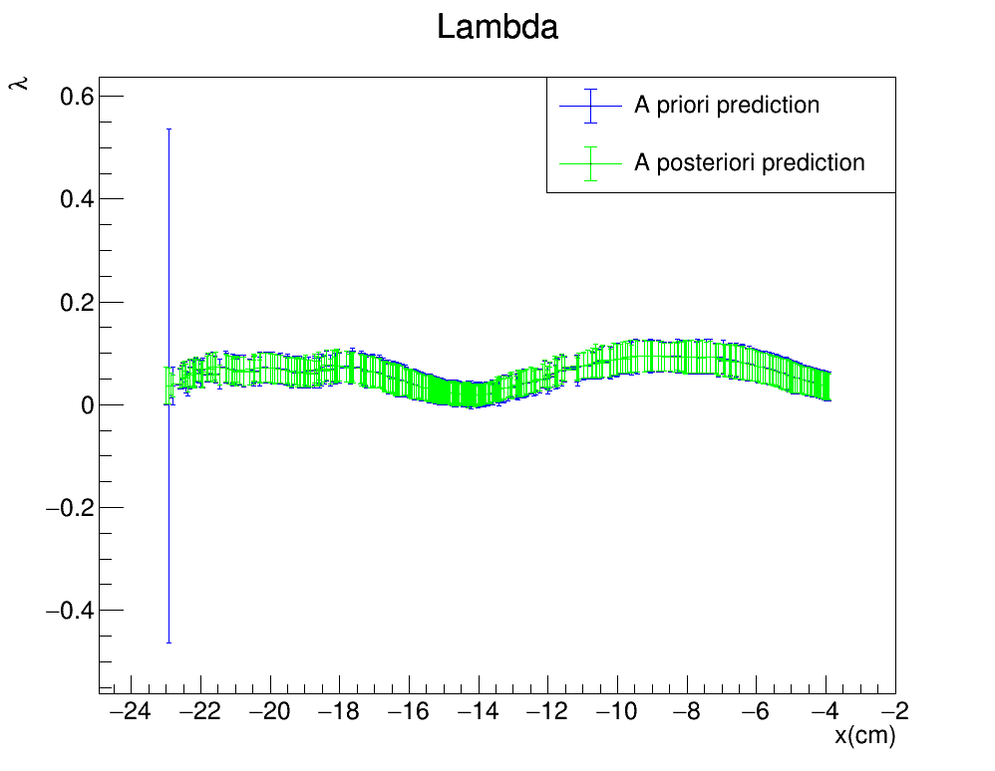
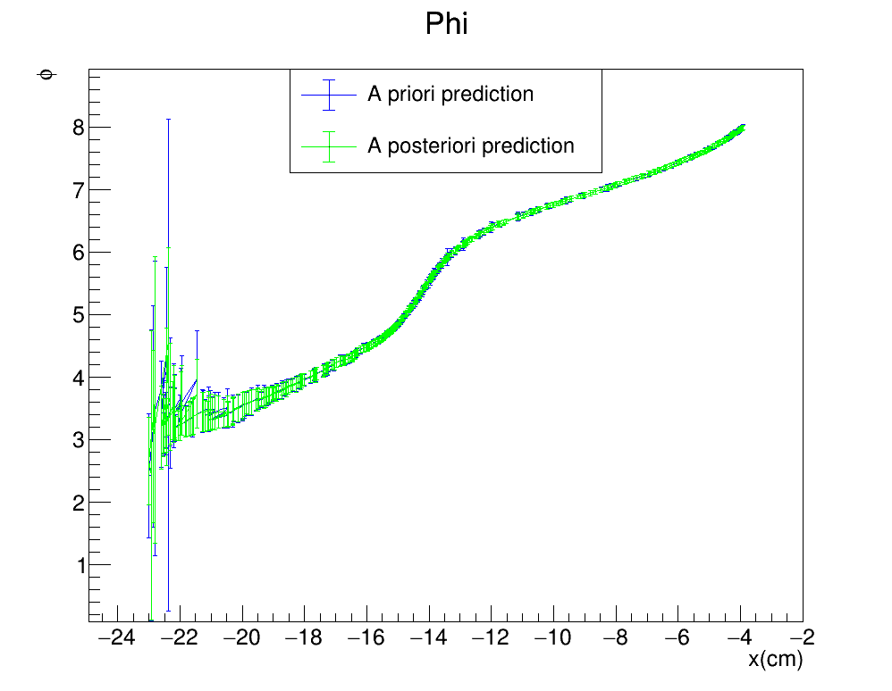

Toy monte carlo: SMEARED Z
KF™$: \left(σ_{x},σ_{yz}\right)=(0.5cm,1cm)$
Gauss$: σ_{Gauss}^{x}=3cm$
FILTER PROPAGATION DIRECTION

Slide 12
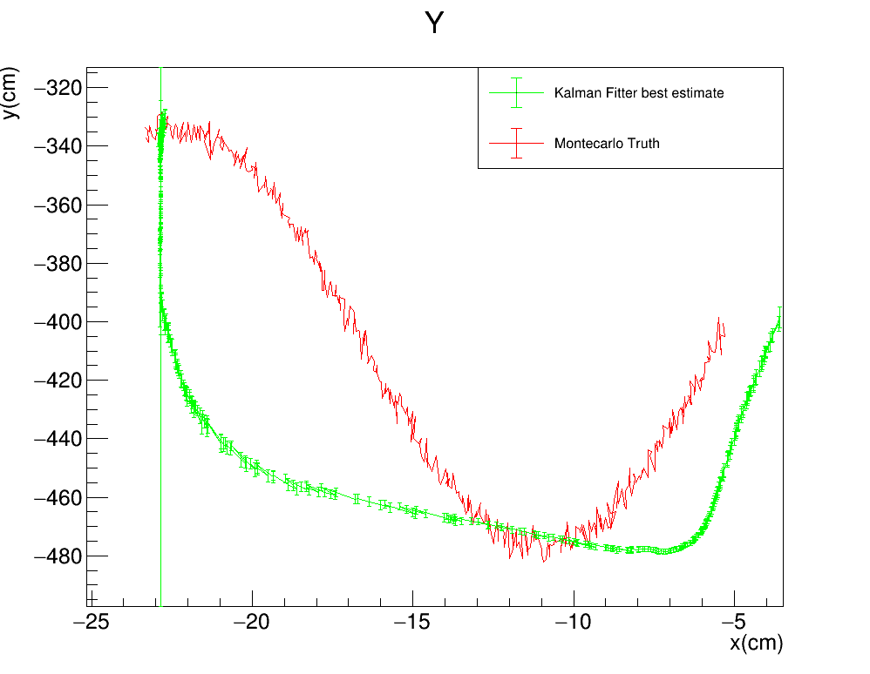
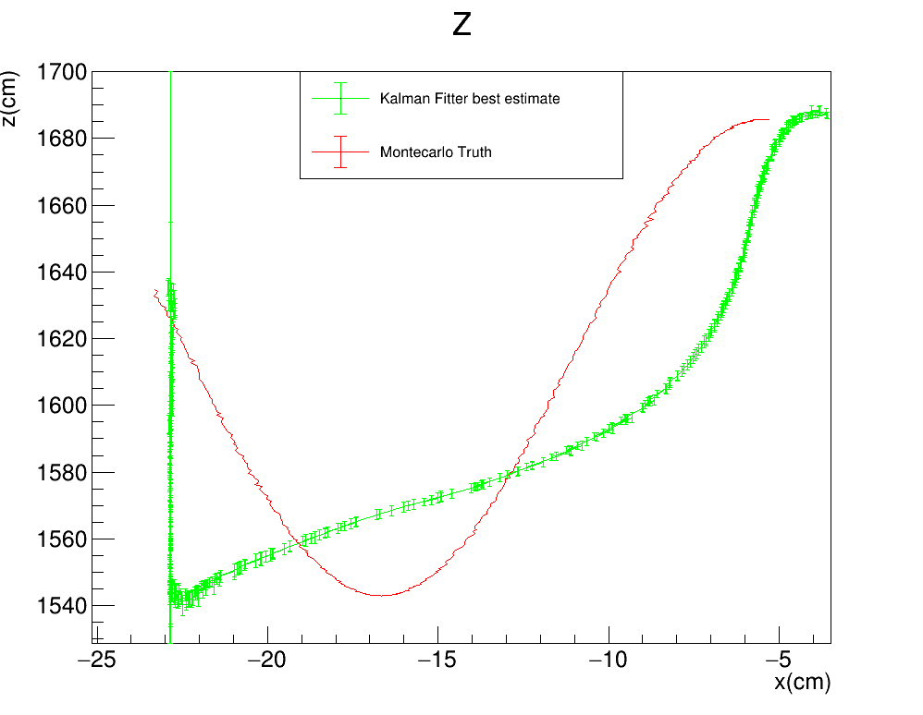

Toy monte carlo: SMEARED XY
KF™$: \left(σ_{x},σ_{yz}\right)=(0.5cm,1cm)$
Gauss$: {(σ}_{Gauss}^{x},σ_{Gauss}^{y})=(0.04cm,3cm)$
FILTER PROPAGATION DIRECTION

Slide 13
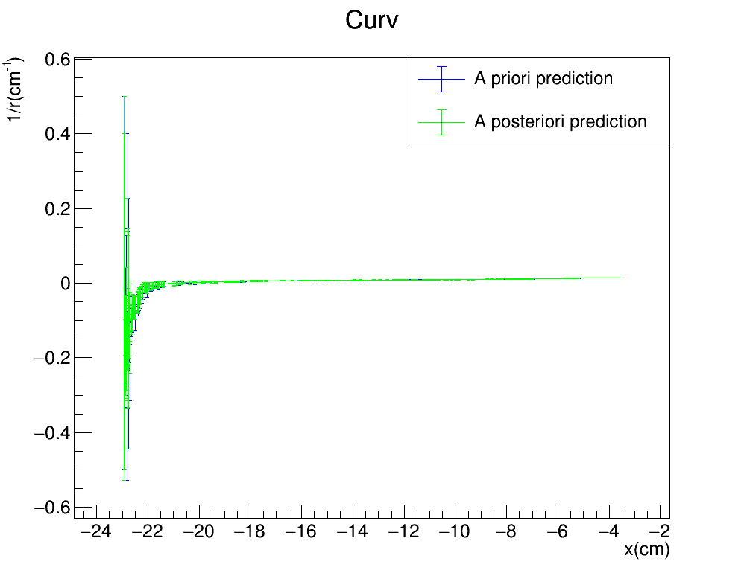
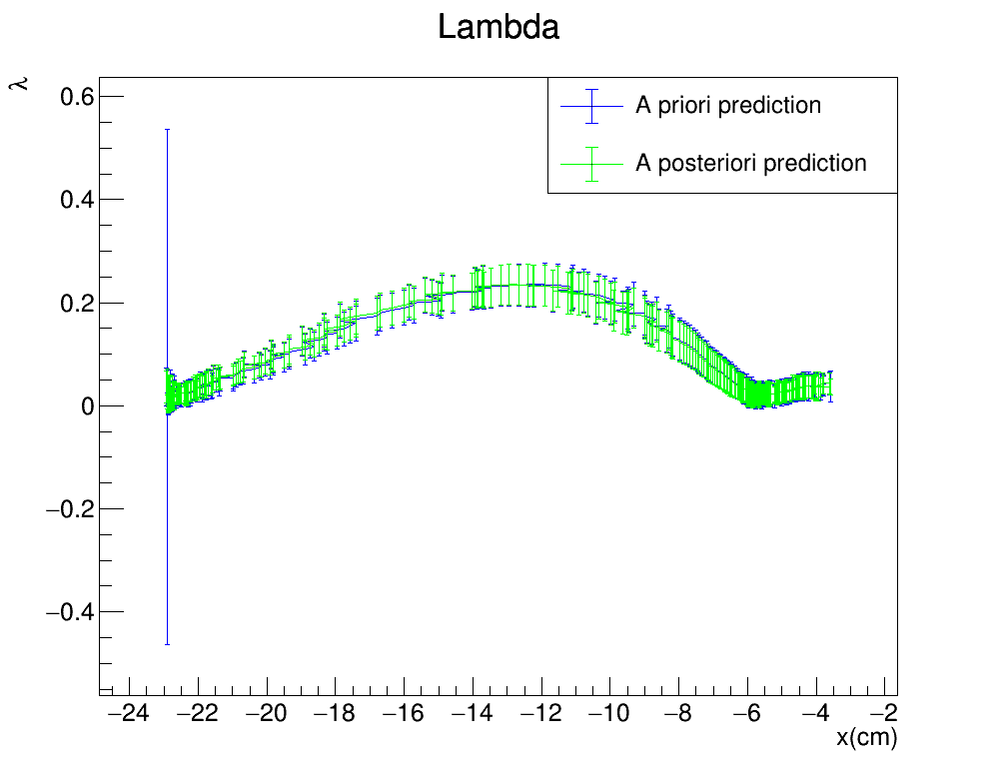
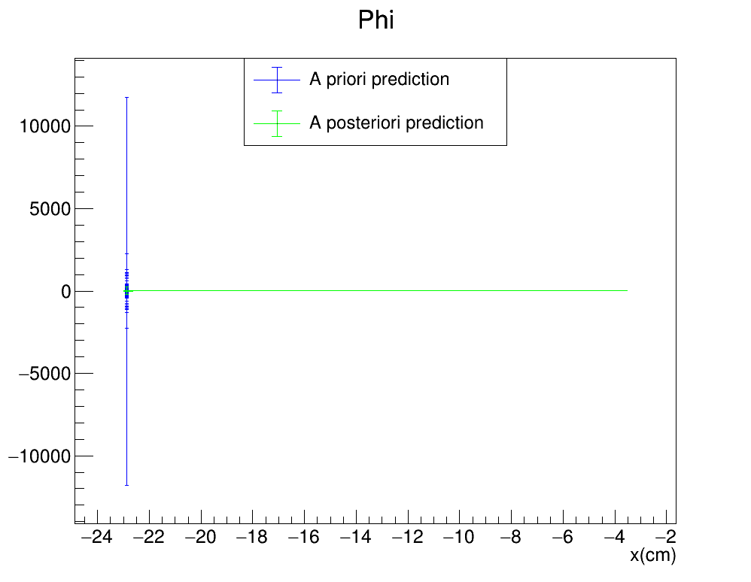
Toy monte carlo: SMEARED XY
KF™$: \left(σ_{x},σ_{yz}\right)=(0.5cm,1cm)$
Gauss$: {(σ}_{Gauss}^{x},σ_{Gauss}^{y})=(0.04cm,3cm)$
FILTER PROPAGATION DIRECTION

Slide 14
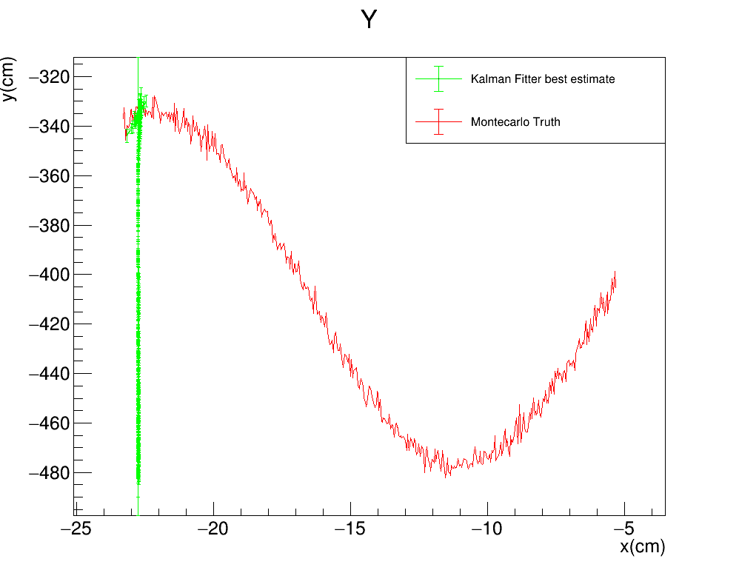
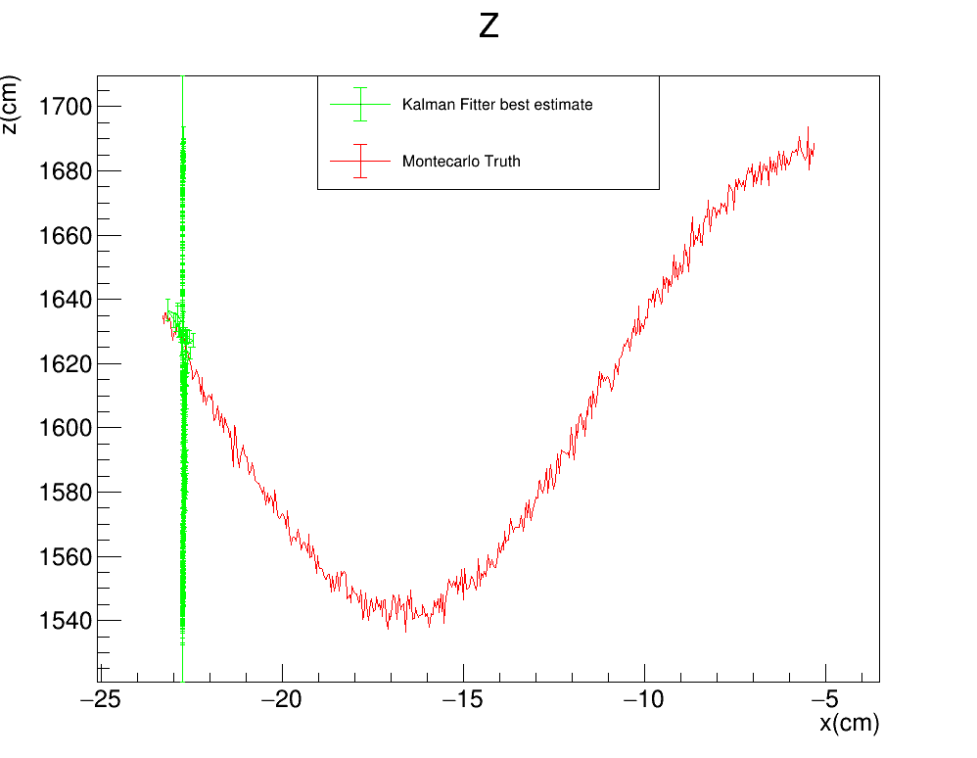

Toy monte carlo: SMEARED YZ
KF™$: \left(σ_{x},σ_{yz}\right)=(0.5cm,1cm)$
Gauss$: {(σ}_{Gauss}^{y},σ_{Gauss}^{z})=(3cm,3cm)$
FILTER PROPAGATION DIRECTION

Slide 15
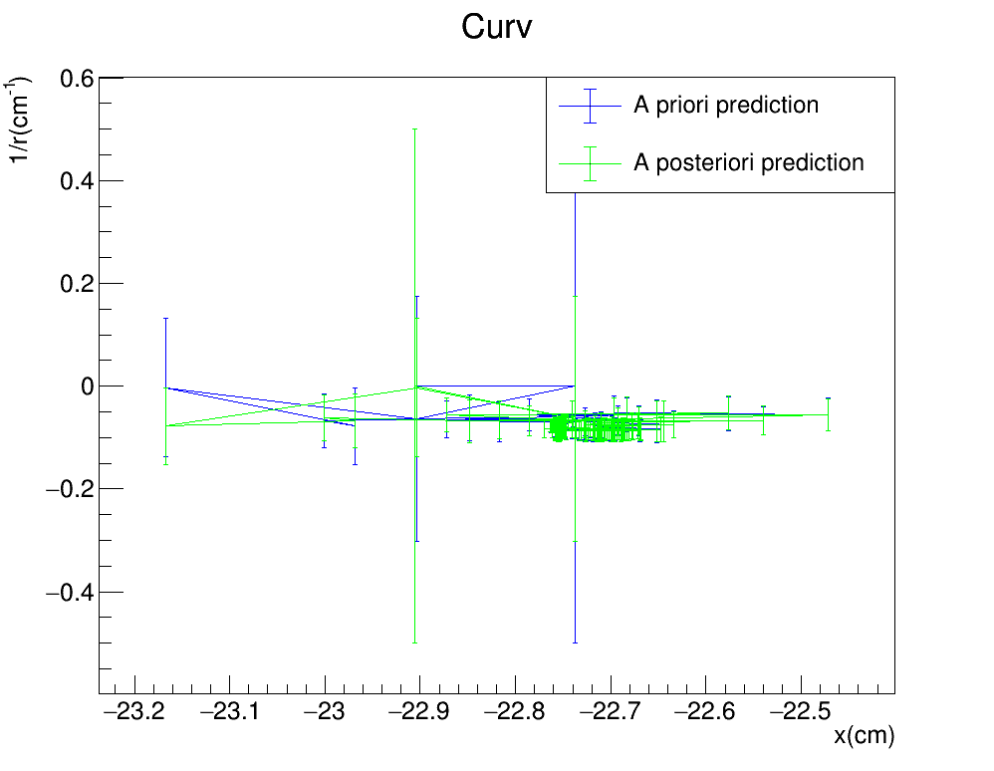
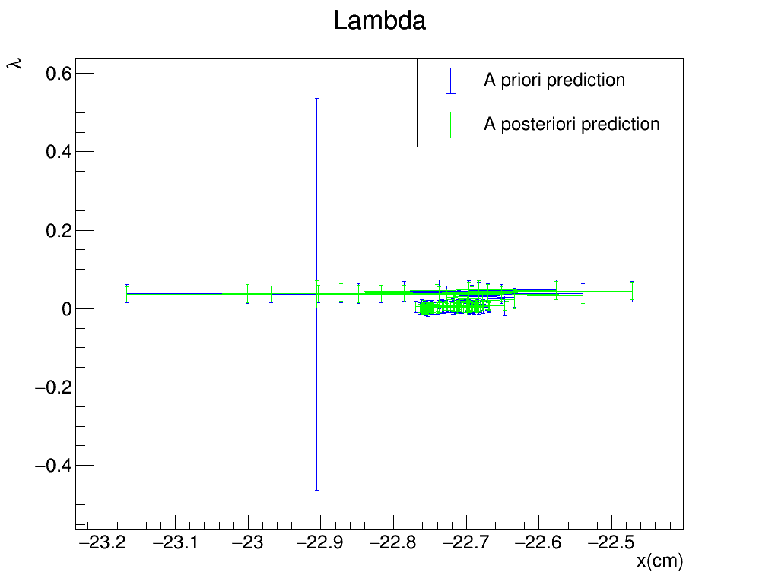
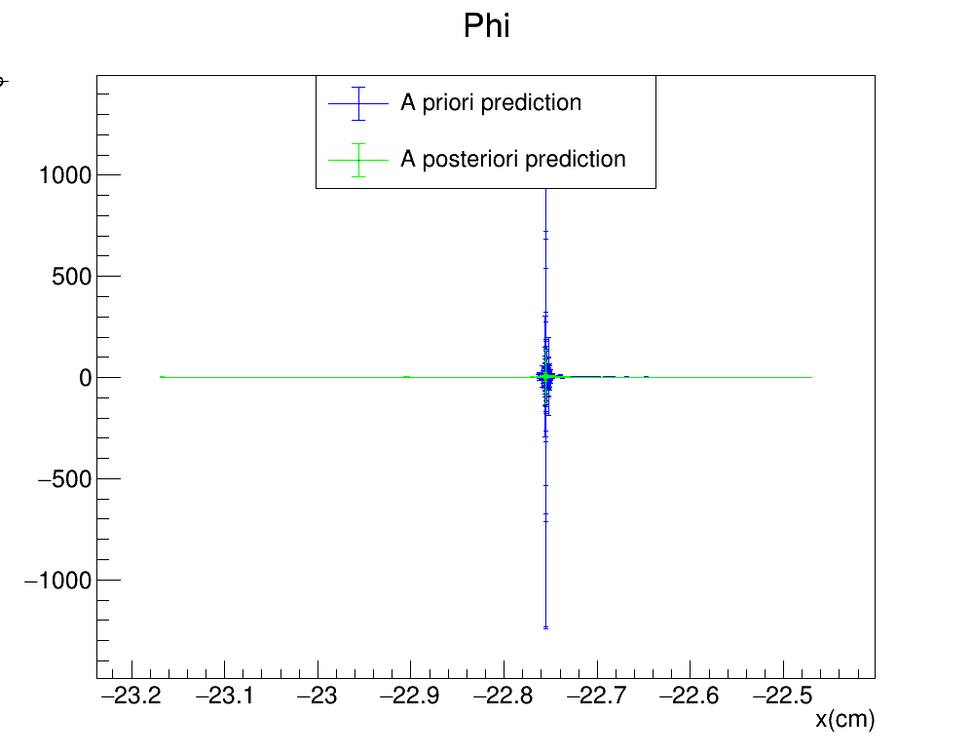
Toy monte carlo: SMEARED YZ
KF™$: \left(σ_{x},σ_{yz}\right)=(0.5cm,1cm)$
Gauss$: {(σ}_{Gauss}^{y},σ_{Gauss}^{z})=(3cm,3cm)$
FILTER PROPAGATION DIRECTION

Slide 16
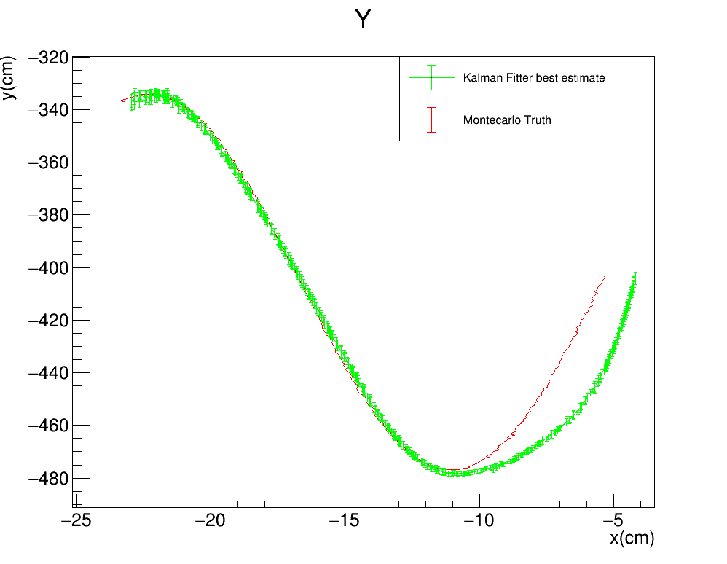
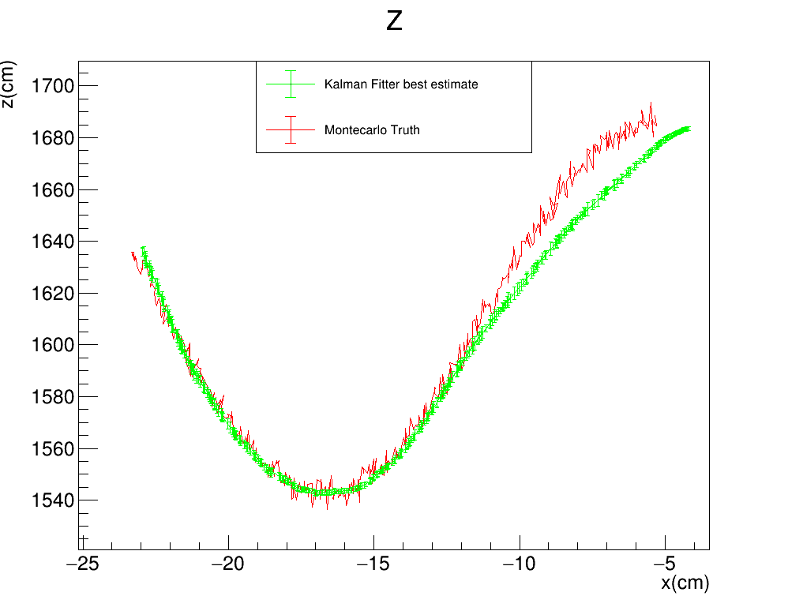

Toy monte carlo: SMEARED XZ
KF™$: \left(σ_{x},σ_{yz}\right)=(0.5cm,1cm)$
Gauss$: {(σ}_{Gauss}^{x},σ_{Gauss}^{z})=(0.04cm,3cm)$
FILTER PROPAGATION DIRECTION

Slide 17
Toy monte carlo: SMEARED XZ
KF™$: \left(σ_{x},σ_{yz}\right)=(0.5cm,1cm)$
Gauss$: {(σ}_{Gauss}^{x},σ_{Gauss}^{z})=(0.04cm,3cm)$
FILTER PROPAGATION DIRECTION

Slide 18
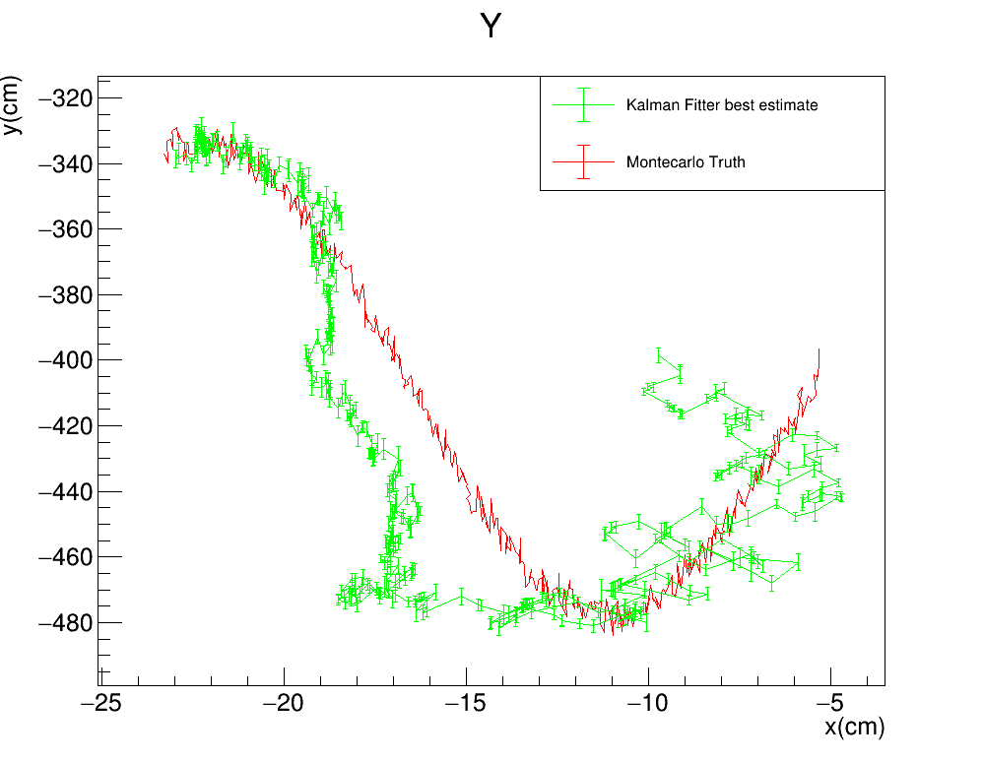
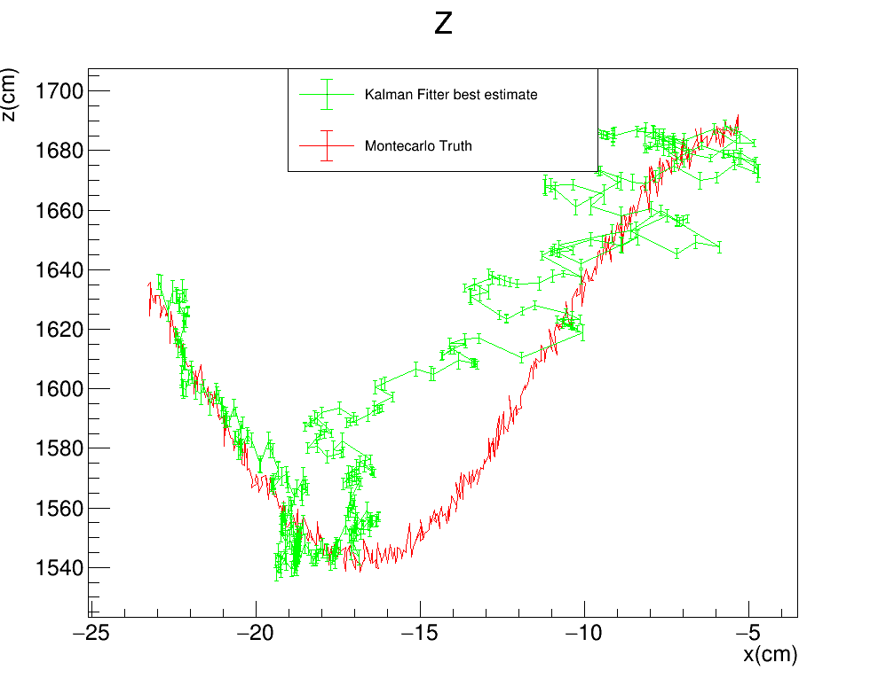
Toy monte carlo: SMEARED XYZ
KF™$: \left(σ_{x},σ_{yz}\right)=(0.5cm,1cm)$
Gauss$: {(σ}_{Gauss}^{x},σ_{Gauss}^{y},σ_{Gauss}^{z})=(0.04cm,3cm,3cm)$
FILTER PROPAGATION DIRECTION

Slide 19
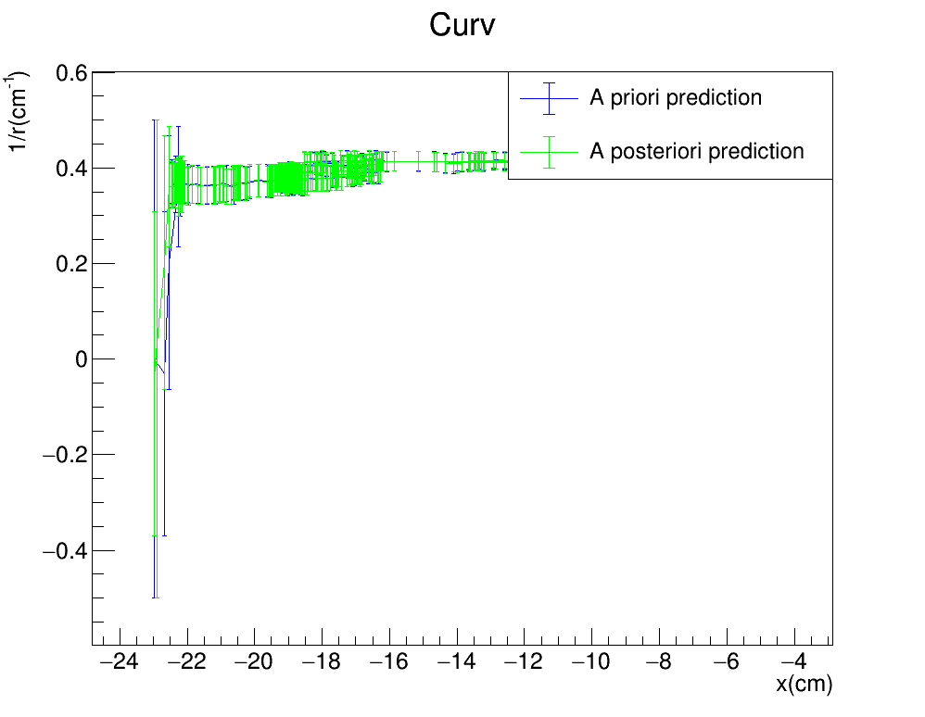
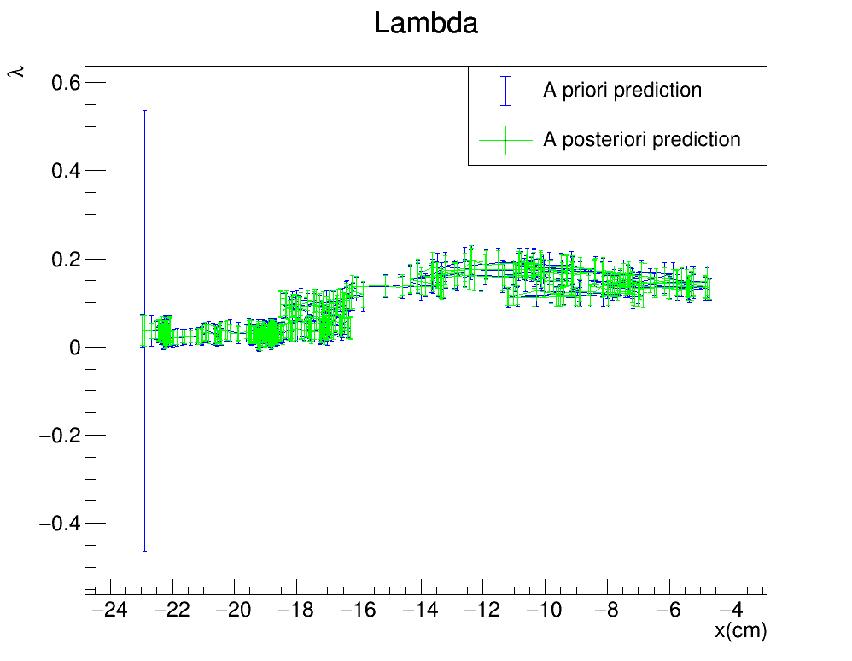
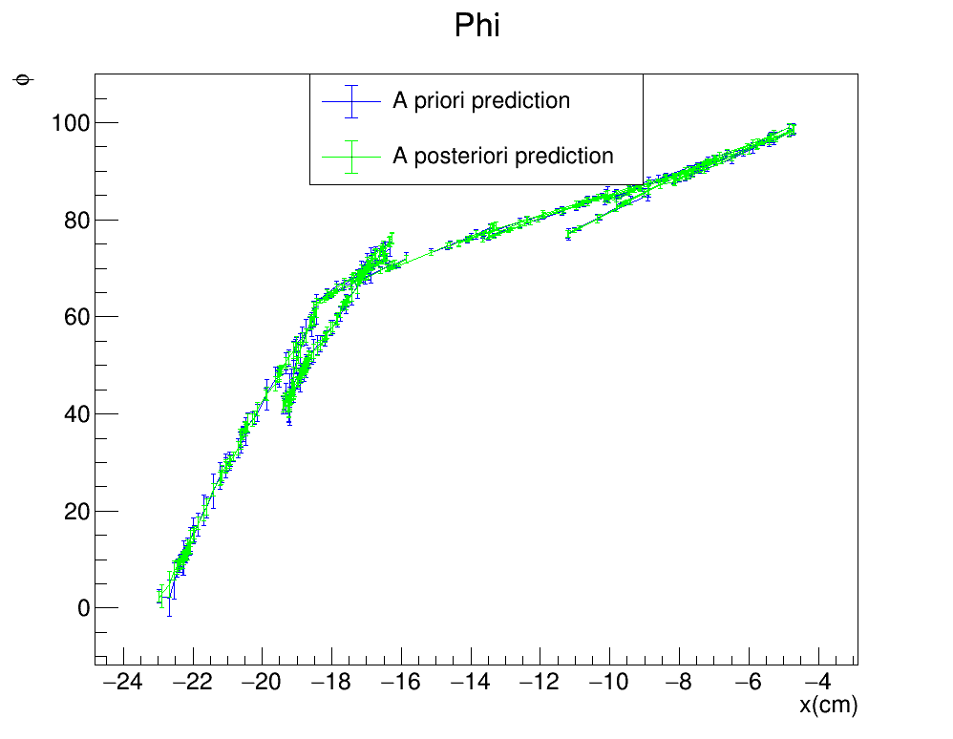
Toy monte carlo: SMEARED XYZ
KF™$: \left(σ_{x},σ_{yz}\right)=(0.5cm,1cm)$
Gauss$: {(σ}_{Gauss}^{x},σ_{Gauss}^{y},σ_{Gauss}^{z})=(0.04cm,3cm,3cm)$
FILTER PROPAGATION DIRECTION

Slide 20
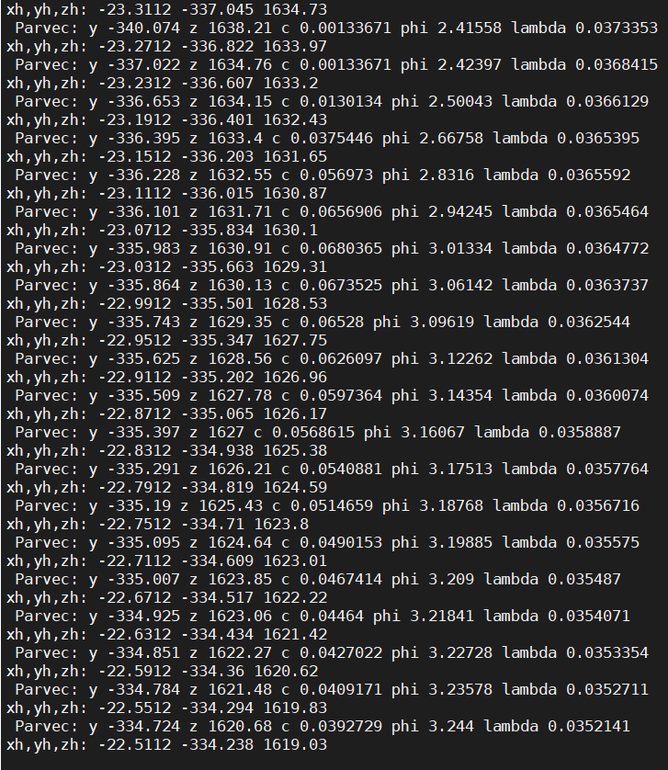
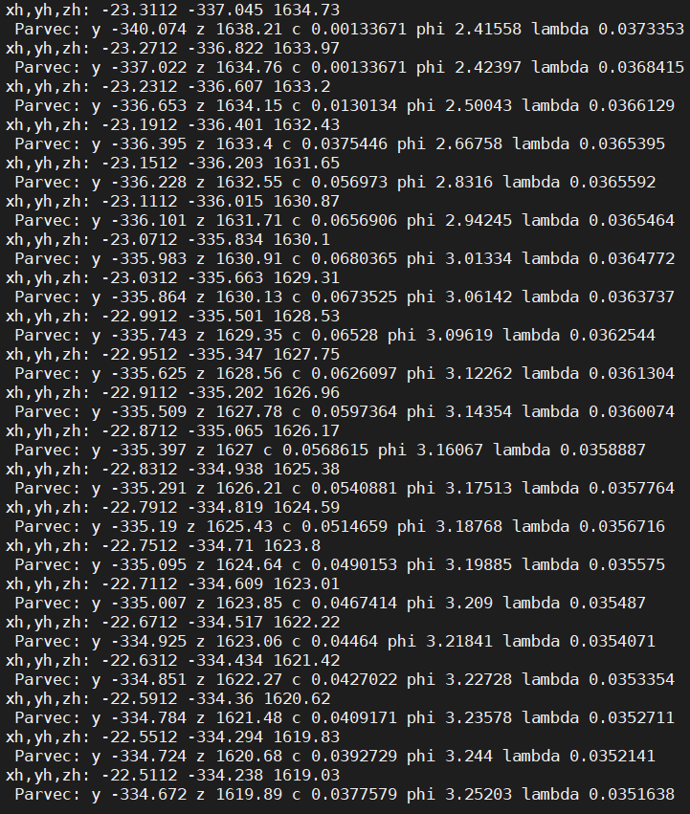
CAREFULL CHECK ON NEW MACRO
OLD METHOD
NEW MACRO

